Slide 1







THE WORLD OF REUSABLE SPACESHIPS
OGBUEHI AGATHA UJUNWA
29th September 2022

Slide 2



OUTLINE
Executive Summary
Introduction
Background of the study
Statement of problem
Question(s) to answer
Methodology
Data collection using API request to webscrapping and BeautifulSoup.
Data wrangling.
Exploration of data using SQL.
Visualization of data using matplotlib and pandas.
Interactive map built with folium and interactive dashboard built with plotly dash.
Machine learning prediction using SVM, DecisionTree, KNN and Logistic Regression.
Results
Discussion
Findings & Implications
Conclusion
Appendix

Slide 3

EXECUTIVE SUMMARY
SpaceX falcon9 has built a spaceship with two stages of which stage one (the main component) has a higher probability of being reusable. This reusable tendency when successful has made the launching of spaceship cheaper than it used to be.
To bid against SpaceX in the space world, it is important to determine the successful landing of stage one, use the specification to build a Space Y spaceship which will be used to bid against SpaceX falcon9 for a better prize.
To do these, many analytic process will be done, and they include;
Data collection using API and webscrapping, wrangling of data to obtain a better comprehensive data, exploration of data using SQL, visualization of data using folium map and plotly dash.
Prediction of successful landing using machine learning.
This whole process will help in predicting successful landing keeping in consideration the features of the spaceship and how it affect landing success. This information will help in the building of Space Y spaceship which will be used to bid against Space X.

Slide 4

INTRODUCTION
BACKGROUND
The exploration of space has been ongoing since 1961 with the first cosmonaut in the person of Yuri Gagarin landing in space. Since then, exploration of space has continued with spaceships being destroyed after launching. These destructions has made landing in space very expensive with other spaceships announcing the use of $165 million for manufacturing and launching of spaceship, while Elon Musk is announcing $65million for reusable manufacturing of spaceships since the major component is already available. The reusable spaceship has made landing in space cheap. Bidding against SpaceX will require the manufacturing of reusable spaceships too.
THE PROBLEM STATEMENT
What are the factors that determine the landing success of the reusable component of Space X?
Can a prediction of successful landing be made using SpaceX falcon 9 data?
Is there a relationship between the features of spaceship and the landing success?
PURPOSE OF RESEARCH
To predict the successful landing of SpaceX falcon 9 spaceship to Build Space Y which will bid against Space X.

Slide 5
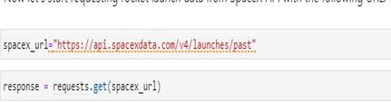
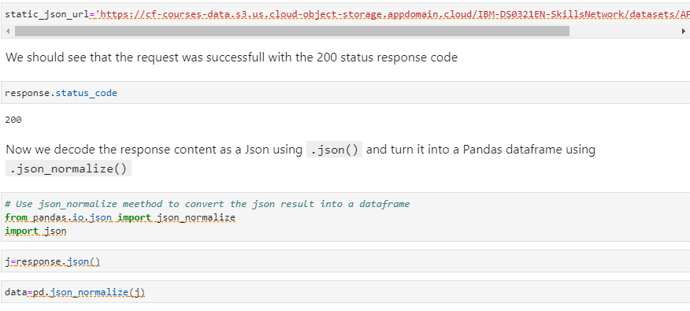
METHODOLOGY
DATA COLLECTION
Data was collected in different ways.
The REST API was used to obtain target launch data Like launch specification, payload delivery, rocket used, landing specification and landing outcome. The URL obtained was used to obtain past launch data. A get request from request library was used to obtain the launch data and the result was passed to .json(), normalized and into a dataframe.
Link to complete process: https://github.com/ujunwa-DS/SPACEX-FALCON-9-CAPSTONE-PROJECT/blob/main/SPACEX%20data%20colLection.ipynb

Slide 6
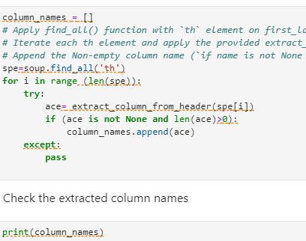
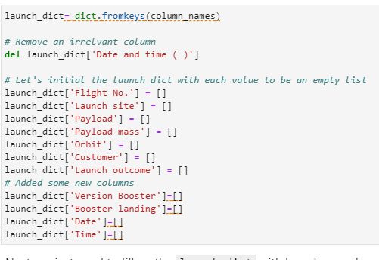
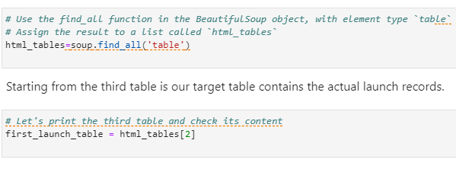
Webscrapping from Wikipedia was done using BeautifulSoup to obtain launch dictionary. The content of the table was extracted using launch_dict= dict.fromkeys(column_names). all the column names were gradually obtained and converted to pandas DataFrame and saved as a csv file.
full process link:https://github.com/ujunwa-DS/SPACEX-FALCON-9-CAPSTONE-PROJECT/blob/main/spacex%20webscraping.ipynb

Slide 7
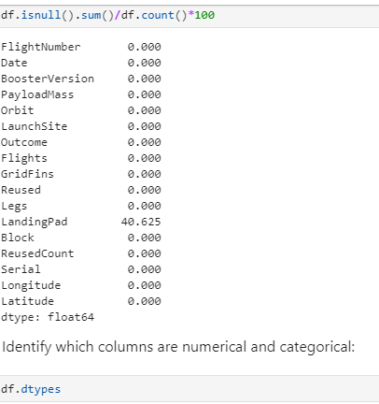
DATA WRANGLING
The data obtained from Beautifulsoup was wrangled using python. Finding the data type, sampling the data, getting the value count, viewing the distinct launch site, including an outcome column to show if the landing was successful or not and dealing with null value to obtain a more comprehensive data which will be visualized, tested and be used for prediction.
Link to complete process: https://github.com/ujunwa-DS/SPACEX-FALCON-9-CAPSTONE-PROJECT/blob/main/DATA%20WRANGLING%20.ipynb

Slide 8
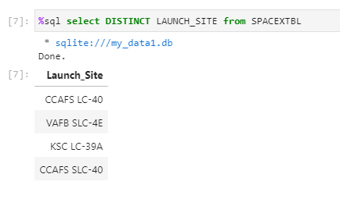
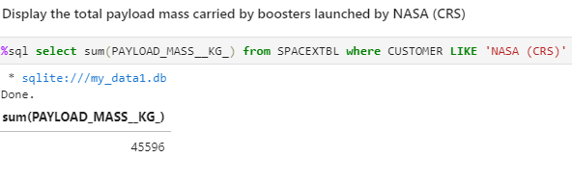
DATA EXPLORATION USING SQL AND MATPLOTLIB
Exploration of data was done in two ways.
1. It was first queried with SQL to obtain important information like average payload, the booster that has carried the highest load, the distinct spaceship, successful and failed missions, etc.
For full process, refer to the link below
https://github.com/ujunwa-DS/SPACEX-FALCON-9-CAPSTONE-PROJECT/blob/main/SPACE%20sql.ipynb

Slide 9
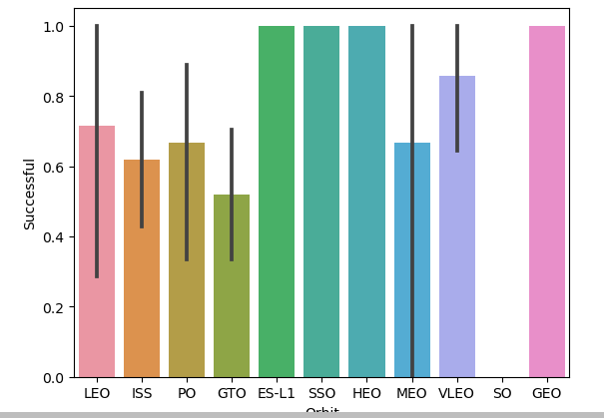
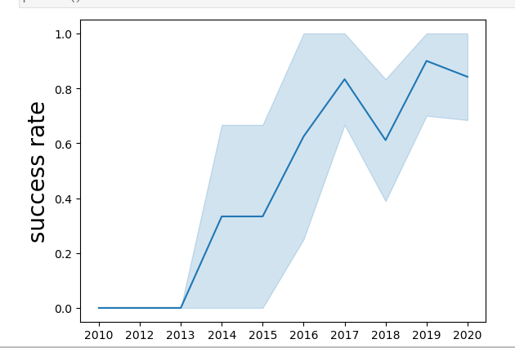
DATA EXPLORATION MATPLOTLIB
LAUNCH SITE AGAINST SUCCESS RATE
The relationship between different parameters of the spaceship was plotted to determine if there is a relationship. Payload, launch site, year of launch were all plotted to determine the relation between parameters and the outcome.
Full process link: https://github.com/ujunwa-DS/SPACEX-FALCON-9-CAPSTONE-PROJECT/blob/main/SPACEX%20DATA%20VIZUALIZATION.ipynb
YEAR AGAINST SUCCESS RATE

Slide 10
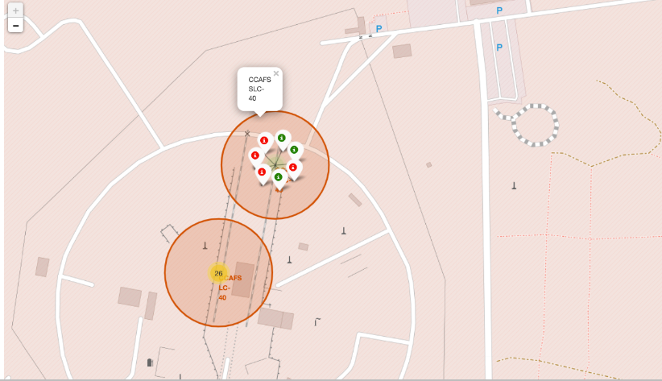
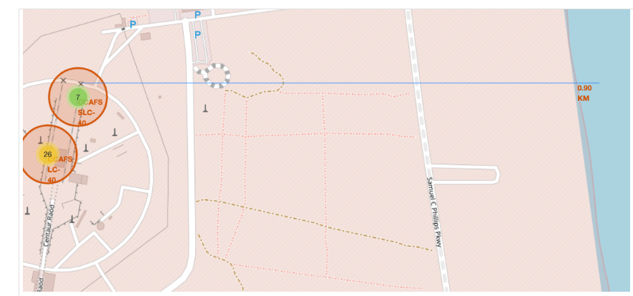
INTERACTIVE MAP WITH FOLIUM
Interactive map of all launch site was done in the following ways;
First the sites of the major launch site were extracted and located on the map;
Successful and failed outcome were marked on the map;
The distance between the map and its proximity was marked;
A line was drawn to show the launch site with their proximities.
Full process link: https://github.com/ujunwa-DS/SPACEX-FALCON-9-CAPSTONE-PROJECT/blob/main/MAP%20INTERACTIVE%20OF%20SPACEX%20.ipynb

Slide 11
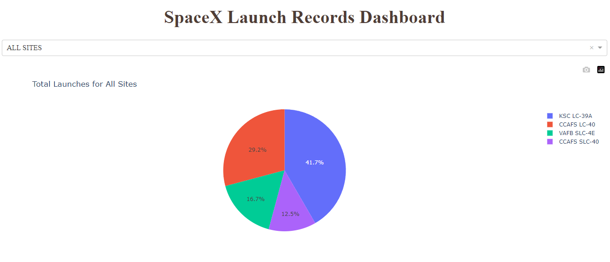
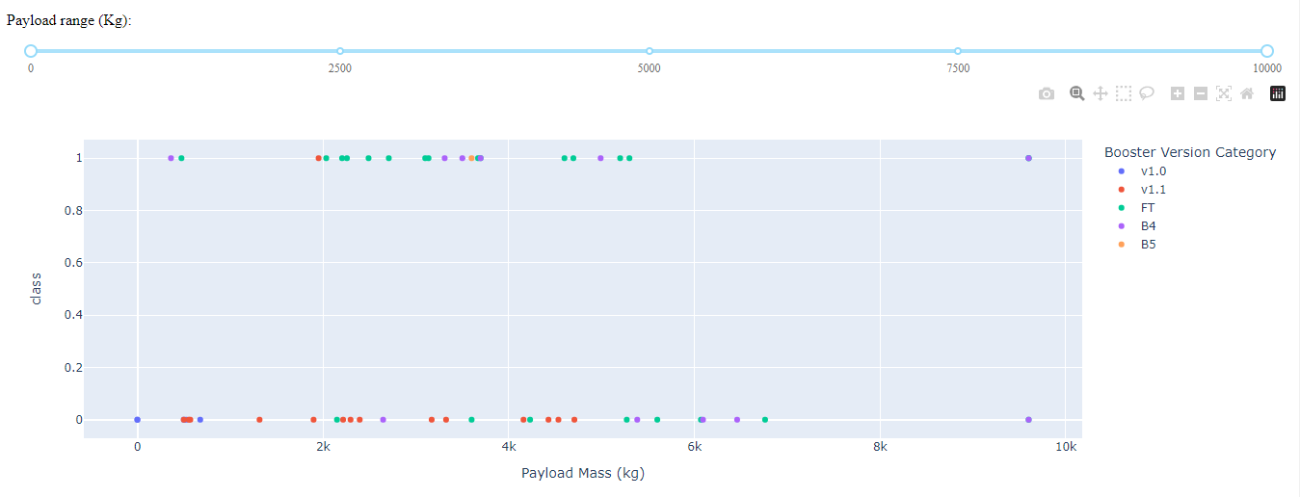
DASHBOARD WITH PLOTLY DASH
A drop down for selection of all launch sites was created.
A pie chart indicating all launch site was created to show the percentage of successful and failed outcome.
A relationship was established between the payload and outcome.
https://github.com/ujunwa-DS/SPACEX-FALCON-9-CAPSTONE-PROJECT/blob/main/DASHBOARD%20SPACEX%20PLOTLY%20DASH.py

Slide 12
PREDICTION (CLASSIFICTAION)
Prediction was done using machine learning classification. The steps followed include;
All needed libraries were imported;
All data was loaded into pandas, transformed and standardized;
The hyperparameters were selected using GridSearchCV
The data was split into test and train and was tested with four classification methods which include KNN, DecisionTree, LogisticRegression and SVM.
The accuracy score of each method was calculated using .score
The best classification method (DecisionTree) with the highest accuracy of 83.34% was obtained.

Slide 13
RESULTS
We had more unsuccessful mission outcome than successful mission outcome.
Some launch sites like HEO, SSO, GEO AND ES-L1 has a high success rate.
Only LEO has a relationship between the success rate and flight number
Heavy payload leads to increase in successful outcome rate in LEO, ISS and POLAR.
From 2014, we had constant increase with successful launch.

Slide 14
DISCUSSION DASHBOARD TRENDS (PAYLOAD, SUCCESS AND FAILED OUTCOME FOR ALL FLIGHTS)
<Bar chart of top 5 programming languages for the current year goes here.>
KSC-LC-39A has the highest with successful percentage of 41.7 followed by CAFS LC-40 with 29.2%, VAFB SLC-4E with 16.7% and the rest is for CCAFS SLC-40.

Slide 15
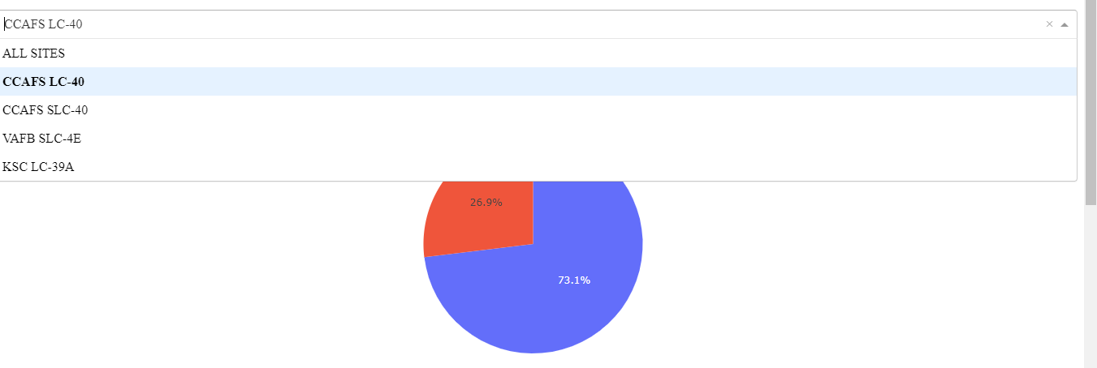
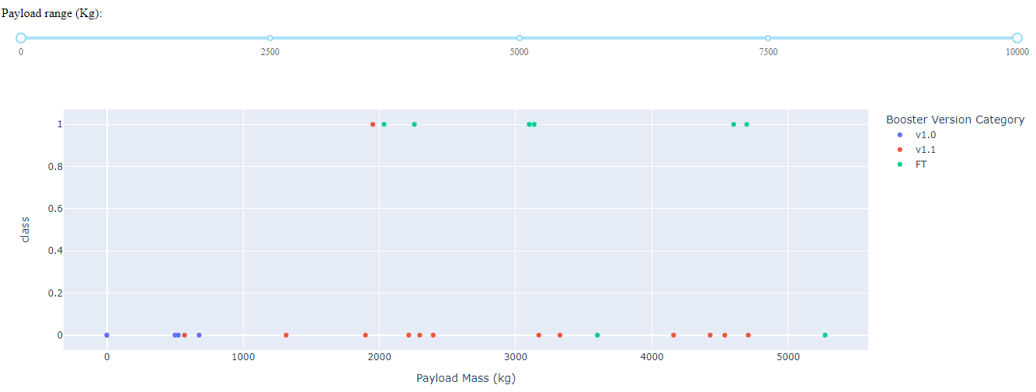
DASHBOARD TRENDS (PAYLOAD, SUCCESS AND FAILED OUTCOME FOR ALL FLIGHTS)
The percentage of successful outcome to failed outcome for CCAFS LC-40 is 73.1% for unsuccessful outcome and 26.9% of successful outcome

Slide 16
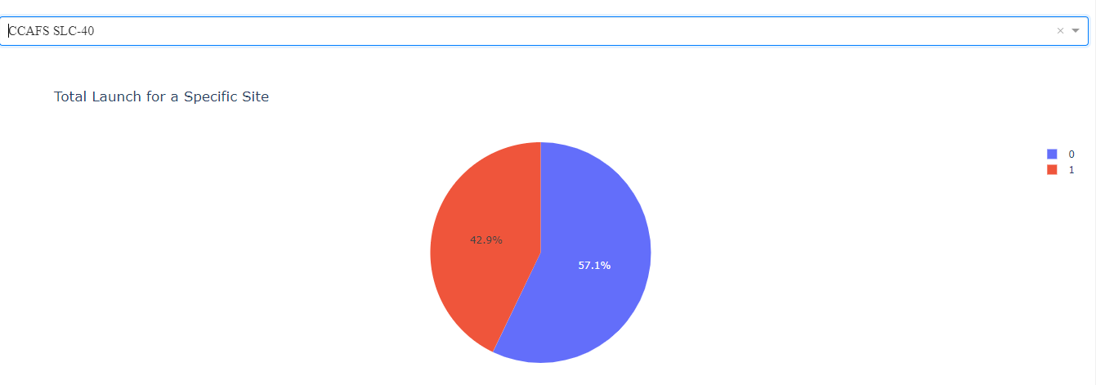
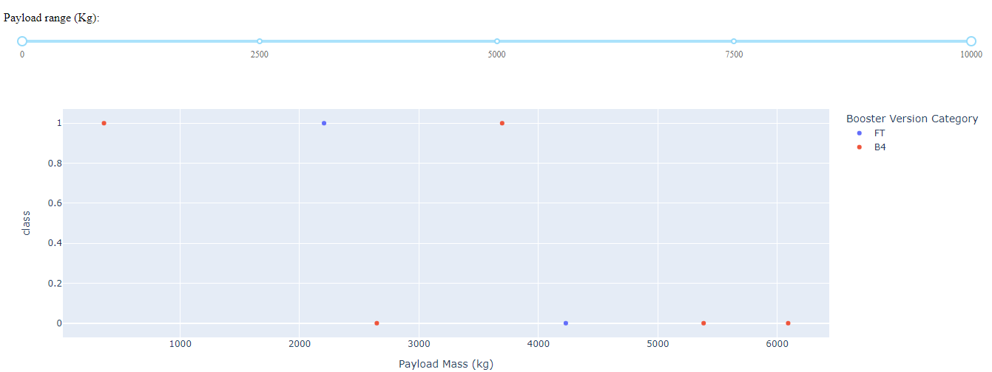
DASHBOARD TRENDS (PAYLOAD, SUCCESS AND FAILED OUTCOME FOR ALL FLIGHTS)
The percentage of successful outcome to failed outcome for CCAFS SLC-40 is 57.1% for unsuccessful outcome and 42.9% of successful outcome.

Slide 17
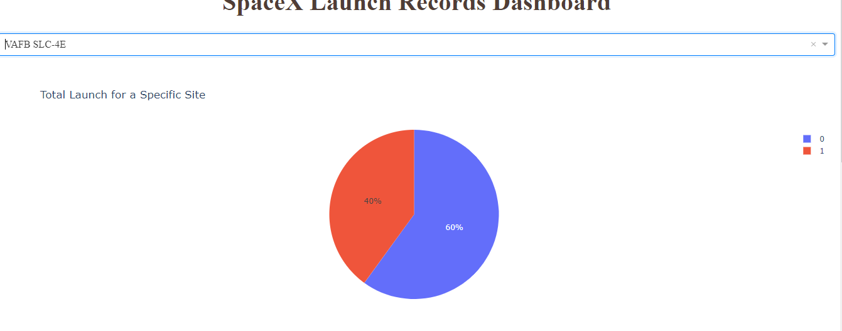
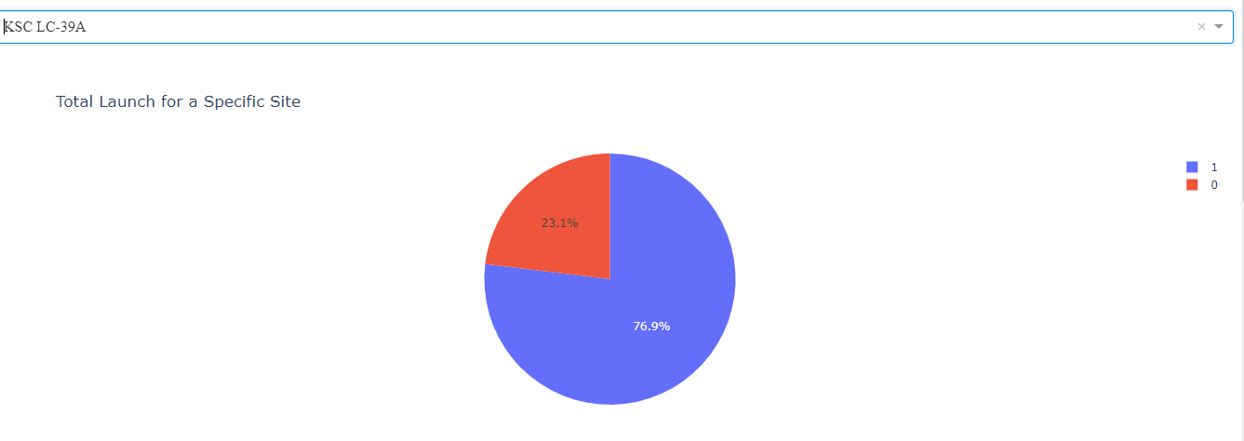
DASHBOARD TRENDS (PAYLOAD, SUCCESS AND FAILED OUTCOME FOR ALL FLIGHTS)
The percentage of successful outcome to failed outcome for KSC-LC-39A is 76.9% successful outcome making it the highest successful launch site and the rest is for of successful outcome. VAFB SLC-4E has a 60% failed outcome with a 40% success rate.

Slide 18
Orbit relationship with success rate
GEO, SSO, HEO and ES-L1 have higher successful rate.

Slide 19
Payload relationship with success rate
There is no concrete relationship between some flights and their payload except polar, ISS and LEO.

Slide 20
Year relationship with success rate
Success rate increased with the increase in a year even though there was a slight decrease in success rate between 2017 to 2018.

Slide 21
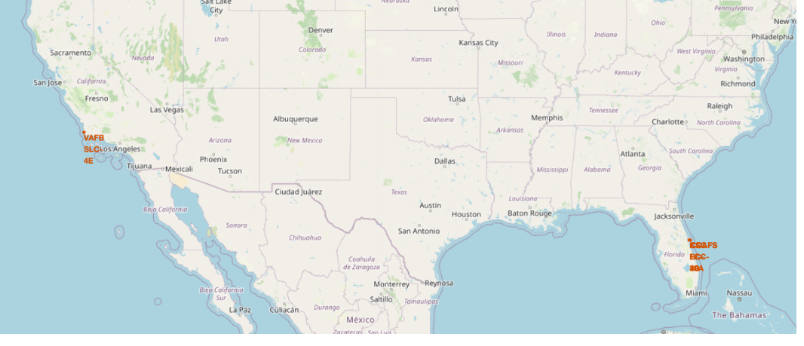
GLOBAL MAP LOCATION OF LAUNCH SITE

Slide 22
SUCCESSFUL and failed OUTCOME ON A MAP

Slide 23
Distance between a laun site and its closest city

Slide 24
Prediction
Classification method was used for prediction. The accuracy obtained was 83.33% for the KNN and SVM but for DecisionTree, an accuracy of 83.34% was obtained, making it the most accurate method of classification.
Confusion matrix was plotted and it showed low level of true negative with a little bit of false negative (false prediction that states that there was a successful landing when in fact there was unsuccessful landing).

Slide 25

CONCLUSION
There is no significant relationship between payload and successful launching.
Higher launch amount increases the tendency of having more successful outcome.
HEO, GEO, ES-L1 has the highest successful orbit.
Success rate started to increase from 2013.
KSC LC-39A is the highest success launch site.
Decision tree with accuracy of 83.34% is the best method to classify.

Slide 26
Appendix
DATA USED
Links to the data used:
https://github.com/ujunwa-DS/SPACEX-FALCON-9-CAPSTONE-PROJECT/blob/main/Spacex.csv
https://cf-courses-data.s3.us.cloud-object-storage.appdomain.cloud/IBM-DS0321EN-SkillsNetwork/datasets/spacex_launch_geo.csv

